Slide 1
DigiHaul Data Science Lead
Take-home test
Garimella Naga Chaitanya
August 2024

Slide 2

Problem Statement
Road haulage is essential for the people and businesses of the UK. Approximately 90% of all goods transported by land in Great Britain are moved directly by road. DigiHaul is a digital transport business, specializing in managing, consolidating and integrating data from both Carriers and
Shippers to deliver seamless end-to-end logistics service. Shippers book shipments on the DigiHaul platform, detailing the scheduled collection and delivery time windows / locations and required vehicle types for carriers to consider. Once a carrier accepts a job and collection is scheduled, DigiHaul’s driver app facilitates real-time tracking of shipments through GPS signals, subject to carriers granting permissions for location logging.

Slide 3
Data Exploration
GPS Data
Shipment Number – Unique identifier of Shipment - 3245 unique shipments in between October 2023 to December 2023
Longitude and Longitude of shipment
Record Timestamp – Date and time stamp as in when the GPS is recorded
Considered as actual delivery time for every shipment number
Latest GPS is the most recent GPS location update for each shipment.
Say Suppose for this Shipment number latest GPS recorded is at 3:59 PM on 30th November 2023, same is assumed to be actual delivery time
Shipment Booking Data
Shipment Number – Unique identifier of Shipment - 3245 unique shipments
Project ID – Under which multiple shipment bookings are defined
First Pick up (collection) and last delivery post code
First Pick up (collection) and last delivery Longitude and Longitude of shipment
First pick up (collection) earliest time stamp – From 29th September 2023 to 31st December 2023
First pick up (collection) latest time stamp – From 1st October 2023 to 31st December 2023
Last delivery earliest time stamp – From 1st October 2023 to 3rd January 2024
Last delivery latest time stamp - From 1st October 2023 to 3rd January 2024
Filtered shipment bookings between 1st October 2023 to 31st December 2023
Merged filtered shipment bookings with Latest GPS, to map the actual (latest) delivery time (recorded time stamp)

Slide 4
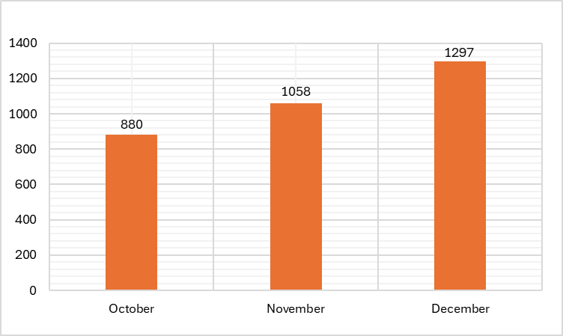
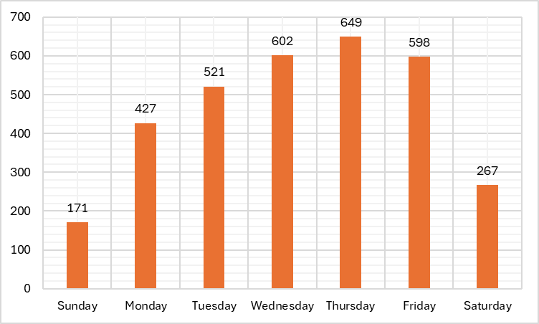
Data Findings
Q4 2023 Month Wise Deliveries
Q4 2023 Day of week Deliveries
December saw the highest number of deliveries, potentially reflecting peak operational performance
Positive Trend: The chart shows a clear upward trend in on-time deliveries as the quarter progresses, indicating improvements in operational efficiency or other contributing factors.
Implications: This increase could be due to better planning, favorable conditions, or enhanced carrier performance as the quarter advanced.
Strongest performance in on-time deliveries occurs midweek, particularly on Thursday.
Lowest performance observed on Sunday, suggesting potential areas for operational improvement or lower demand.
Weekday Peak: The chart clearly shows that weekdays, particularly Wednesday and Thursday, have the highest number of on-time deliveries.
Weekend Dip: There is a sharp decline in on-time deliveries over the weekend, with Sunday being the lowest and Saturday also relatively low.

Slide 5
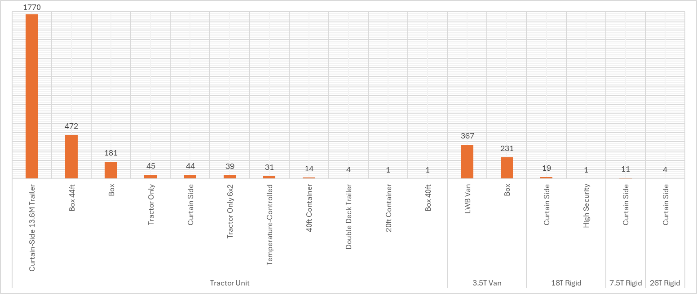
Data Findings Cont.
Vehicle Size and Vehicle Build UP wise Deliveries
Dominance of Curtain-Side 13.6M Trailer: The overwhelming majority of deliveries were made using Curtain-Side 13.6M Trailers, suggesting these are heavily relied upon for transport.
Diversity of Vehicle Use: The chart highlights that while certain vehicle types are predominant, there is a wide variety of vehicle configurations used to meet different shipping requirements.
Significant variety in vehicle types used, but many have a much smaller share of deliveries

Slide 6
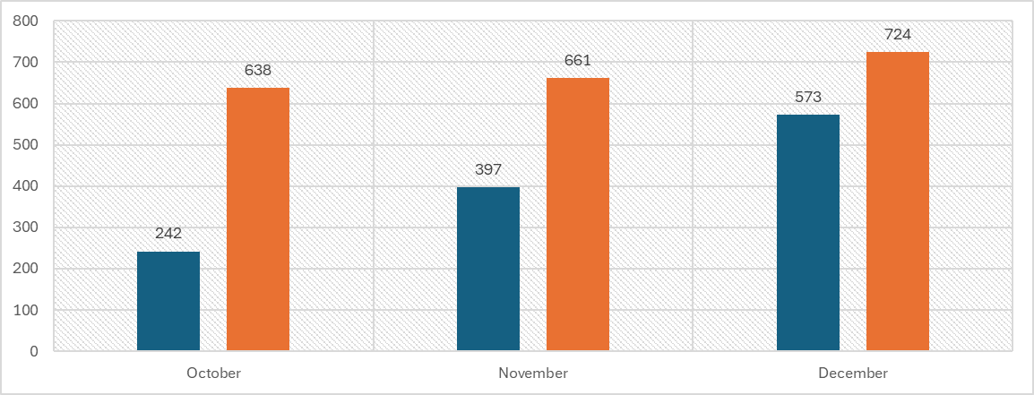
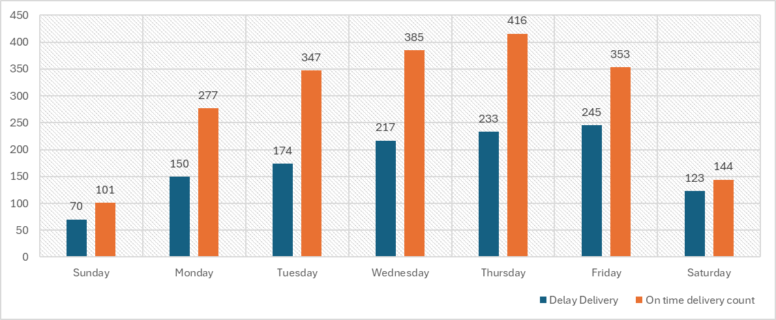
On Time Delivery – Task 1 (KPI)
Determine whether shipments were delivered on time:
Actual Delivery Time: It looks at the recorded delivery time (RECORD_TIMESTAMP), which is the time when the shipment was delivered.
Scheduled Delivery Time: It also considers the scheduled delivery deadline (LAST_DELIVERY_SCHEDULE_LATEST), which is the latest time the shipment was supposed to be delivered.
Buffer Period: To allow for some flexibility, it adds an extra 30 minutes to the scheduled delivery time. This means a delivery is still considered "on-time" if it happens within 30 minutes after the scheduled deadline.
Comparison: Comparing the actual delivery time to this adjusted deadline. If the delivery was on or before the adjusted time, it marks the shipment as "on-time" (True). If it was later, it's marked as "late" (False).
Importance of On-Time Delivery for Business Operations
Critical Role in Supply Chain
Impact on Customer Satisfaction
Operational Efficiency
The overall percentage of shipments met the on-time delivery threshold (arriving no later than 30 minutes past the scheduled delivery window) is 62.53%

Slide 7
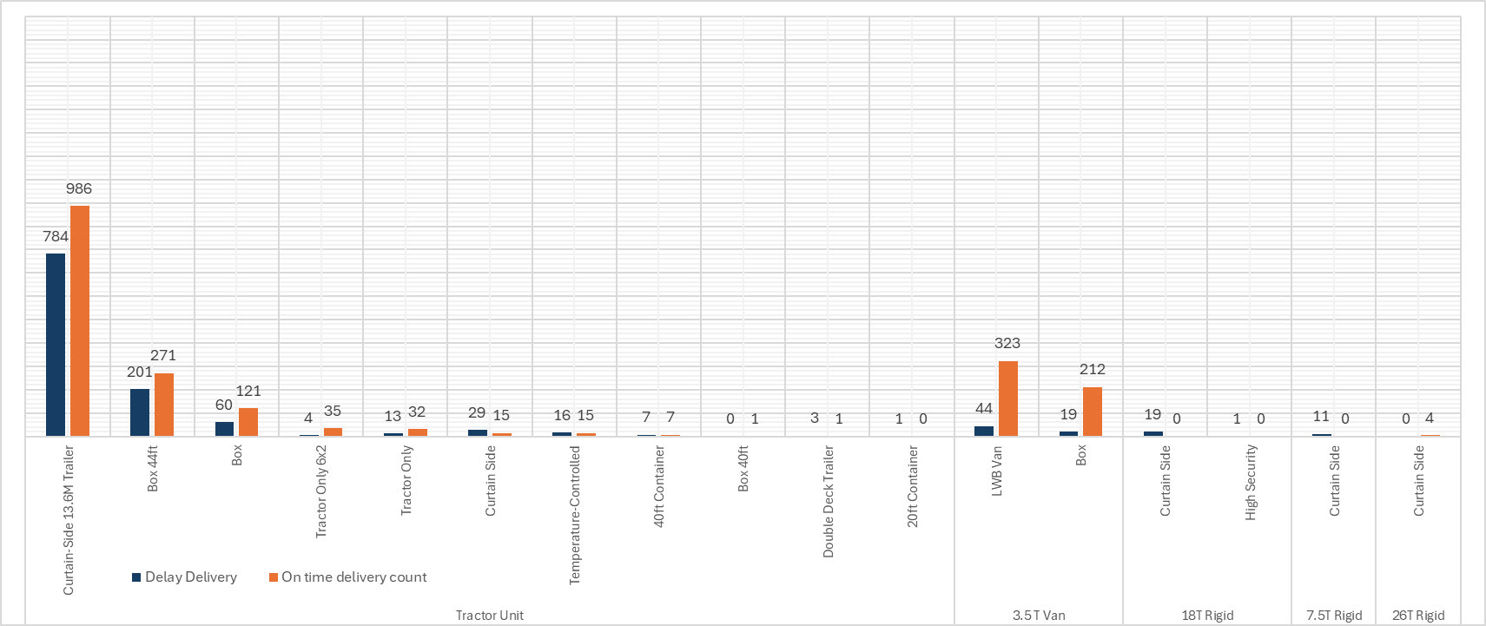
On Time Delivery
Vehicle Size and Vehicle Build UP wise Deliveries
The vehicles with higher usage (Curtain-Side 13.6M Trailer, Box 44ft) tend to have higher delays, which could indicate issues related to high demand, capacity, or operational challenges.
Smaller vehicles like the LWB Van and Box in the 3.5T Van category show fewer delays relative to their on-time deliveries, suggesting better efficiency or fewer challenges with these vehicle types.
The lower delay counts in less-used vehicle types suggest that as usage increases, operational efficiency might decline, leading to more delays.

Slide 8
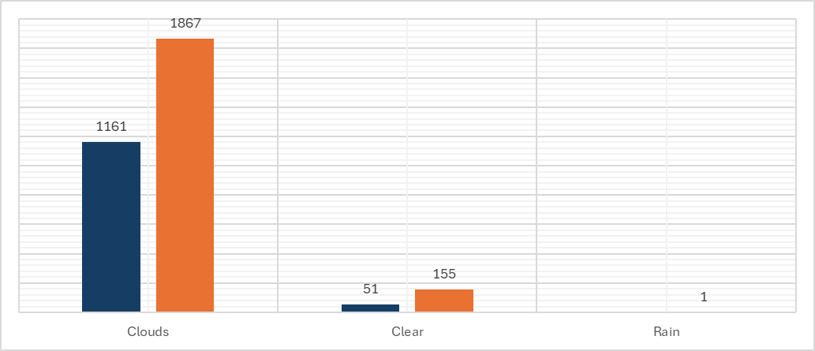
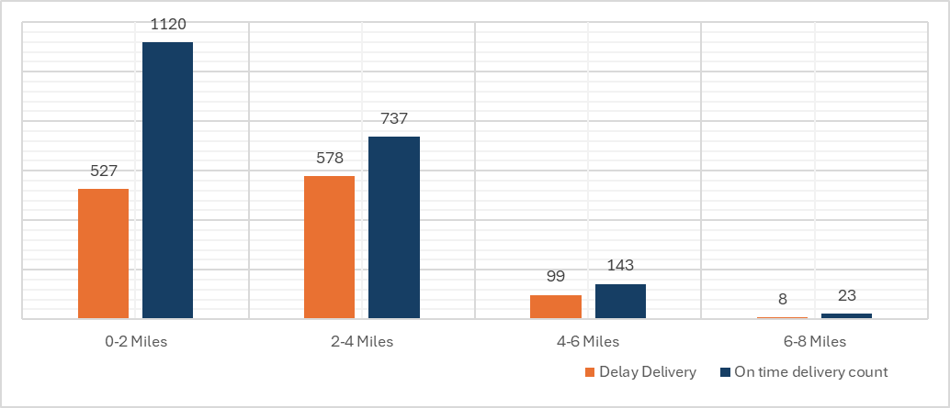
On Time Delivery
Weather (Additional data source) wise deliveries
Through APIs calls gathered relevant weather daa, which is the key factor for on time delivery.
Impact of Clouds on Deliveries: The data indicates that cloudy weather is associated with a higher likelihood of delayed deliveries. This could be due to various operational challenges such as visibility issues, or other weather-related impacts.
Clear Weather Delays: Unexpectedly, even in clear weather, there are more delays than on-time deliveries. This might point to non-weather-related issues like traffic, logistical challenges, or other factors.
Minimal Data for Rain: The small sample size for rain makes it difficult to draw definitive conclusions, but it does highlight the significant challenges posed by rain in the delivery process.
Distance wise deliveries
Distance calculated between the collection and delivery points of each shipment based on their latitude and longitude coordinates
Based on the minimum distance (in miles) and maximum distance categories are created like 0-2 Miles, 2-4 Miles, 4-6 Miles and 6-8 Miles.
Shorter Distances (0-2 Miles, 2-4 Miles): There is a high volume of deliveries within these distances, but also a significant number of delays. This suggests that even over shorter distances, there are challenges that prevent timely delivery.
Longer Distances (4-6 Miles, 6-8 Miles): As the distance increases, the total number of deliveries decreases. However, the ratio of on-time deliveries improves slightly in the 6-8 miles range, possibly due to better planning or less traffic interference over longer routes.

Slide 9
Delay Prediction
Shipment bookings data is considered as a training dataset with target variable on-time delivery namely ‘True’ and ‘False’ (likelihood of delay)
Delay can be of multiple reason,
vehicle build up
vehicle size
delivery window (how long the delivery window is for each shipment, in hours)
collection window (how long the collection window is for each shipment, in hours)
distance (distance between where the shipment is picked up and where it is delivered, based on their latitude and longitude coordinates)
weather (cloudy, clear or rainy), temperature and wind speed are the external data sources
Random Forest Classifier machine learning algorithm used to predict the likelihood of delay
Handles non-linear relationships between features.
Effective for categorical variables (e.g., vehicle build up, vehicle size).
Provides feature importance scores to understand key delay factors.
Prediction for likelihood of delay with probabilities by shipment number are scored on the new booking data and attached the same.

Slide 10
Technical Deploy Outline
Next Steps
Framework: FastAPI for high performance and ease of use
Infrastructure:
Platform: AWS or Azure for scalability and reliability
Containerization: Docker to package the model and API for easy deployment and scaling.
Orchestration: Kubernetes for managing containerized applications in a production environment.
API Key management for secure access to the prediction service.
Encrypt data in transit using HTTPS.
Secure storage of sensitive information with cloud provider encryption services.
Alerts: Set up alerts for any unusual activity or service downtimes.
Model Performance:
The Random Forest model effectively predicts shipment delays with an 68% accuracy rate.
Time windows and geographical distance are crucial factors in delay prediction.
Business Impact:
Implementing the model can significantly enhance operational efficiency by preemptively identifying potential delays and allowing proactive measures.
Continuous Improvement:
Regularly retrain the model with new data to improve accuracy over time.
Monitor model performance in production and adjust parameters as needed.
Future Enhancements:
Incorporate additional data sources, such as real-time traffic to further refine predictions.
Explore the use of deep learning models for even more accurate predictions.

Slide 11
Q & A

